Slide 1


• We’ll start in a moment :) • We may record tonight’s event and plan to take screenshots for social media. • If you want to remain anonymous, use your first name & keep video off. • We’ll introduce the hosts and break in-between for Q/A. • We will make some time for Q&A at the end of the presentation as well. • Online event best practices: • Mute yourself when you aren’t talking. • Turn on your video if you feel comfortable!
Welcome!

Slide 2

WWCode Digital + Backend
Backend Study Group
March 25, 2021

Slide 3
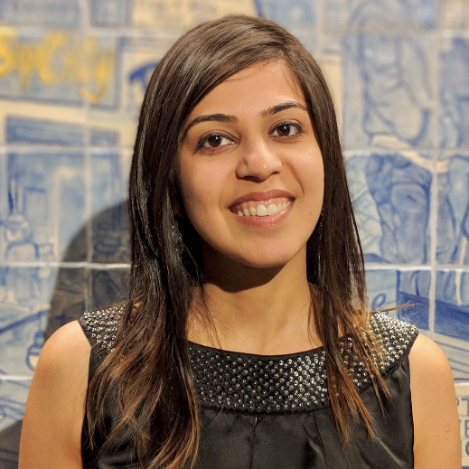

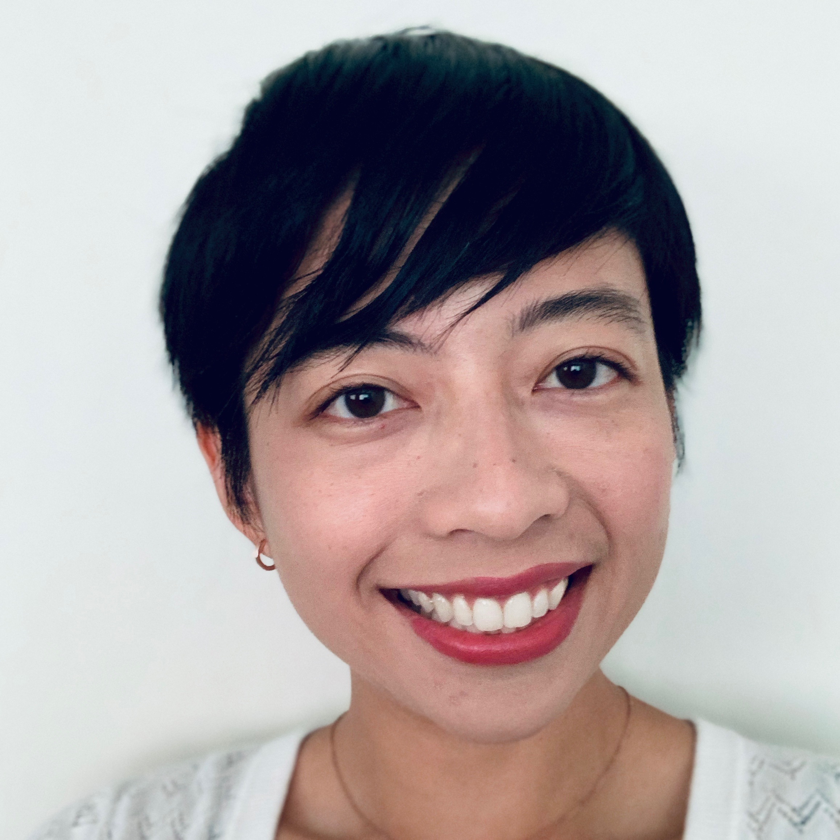
• Welcome from WWCode! • Our mission: Inspiring women to excel in technology careers. • Our vision: A world where women are representative as technical executives, founders, VCs, board members and software engineers.
Prachi Shah
Senior Software Engineer | Metromile
Aditi
Full Stack Engineer | New Relic
Elaine
Student Assistant | Lawrence Berkeley National Lab

Slide 4


CODE OF CONDUCT
WWCode is an inclusive community, dedicated to providing an empowering experience for everyone who participates in or supports our community, regardless of gender, gender identity and expression, sexual orientation, ability, physical appearance, body size, race, ethnicity, age, religion, socioeconomic status, caste, creed, political affiliation, or preferred programming language(s).
Our events are intended to inspire women to excel in technology careers, and anyone who is there for this purpose is welcome. We do not tolerate harassment of members in any form. Our Code of Conduct applies to all WWCode events and online communities.
Read the full version and access our incident report form at womenwhocode.com/codeofconduct

Slide 5
• First ever Backend Study Group session!
• Resources: • GitHub • Upcoming sessions: • April 8, 2021 • April 22, 2021 • Technical Tracks • Digital Events • Get updates – join the Digital mailing list!
Agenda

Slide 6
• Basics of Computer Science. • What is Backend Engineering? • Common terms: Server-side programming, Client-Server architecture, API, Platform, Micro-service, MVC framework, etc. • Other domains: Front end engineering, full stack engineering, design & user experience, mobile development, devOps engineering, machine learning, etc. *
• Examples: Amazon Online Shopping, Instagram, Weather website. * Disclaimer: Roles and responsibilities can vary per company and industry.
Backend Engineering

Slide 7
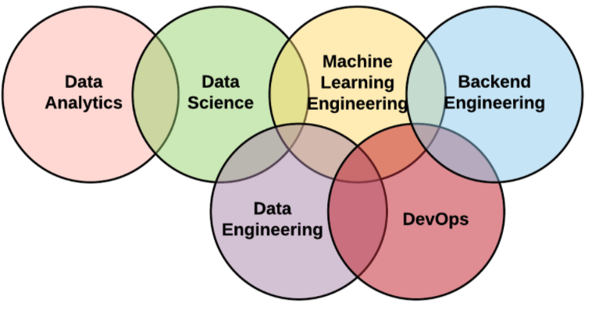
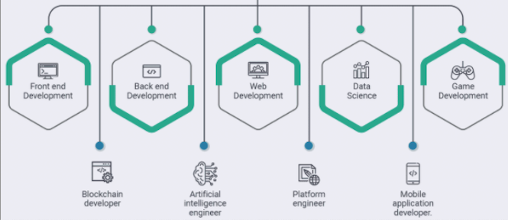
Backend Engineering

Slide 8
• Languages & frameworks & platforms: Java, Python, PHP, Scala, PostgreSQL, MongoDB, MySQL, Oracle, Cassandra, Spring Boot, Node.js, Ruby on Rails, Django, Flask, Express.js, AWS, Kubernetes, etc. • Where to start? • Choose a language and framework. • Learn to serve content to the client. • Basic APIs and HTTP verbs. • CRUD and connection to database. • Security -- authentication (who) -- authorization (what). • Build an application/ product/ feature. • Sub-domains: Application development, DBMS, systems design & architecture, networking systems, cloud computing, performance and scalability, security, IoT, distributed systems, etc.
Backend Engineering

Slide 9
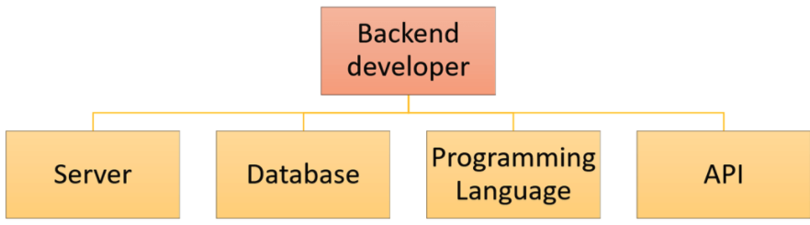
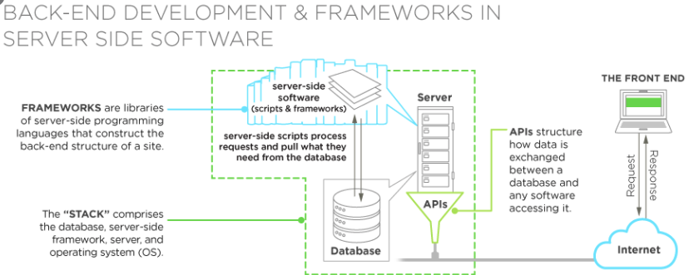
Backend Engineering

Slide 10
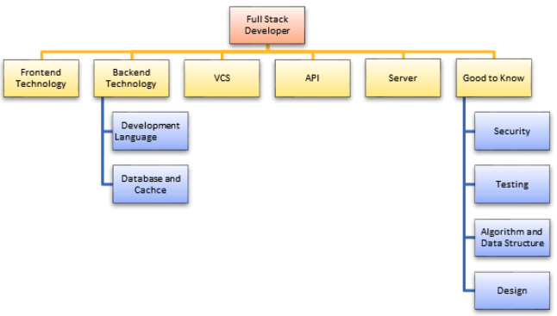
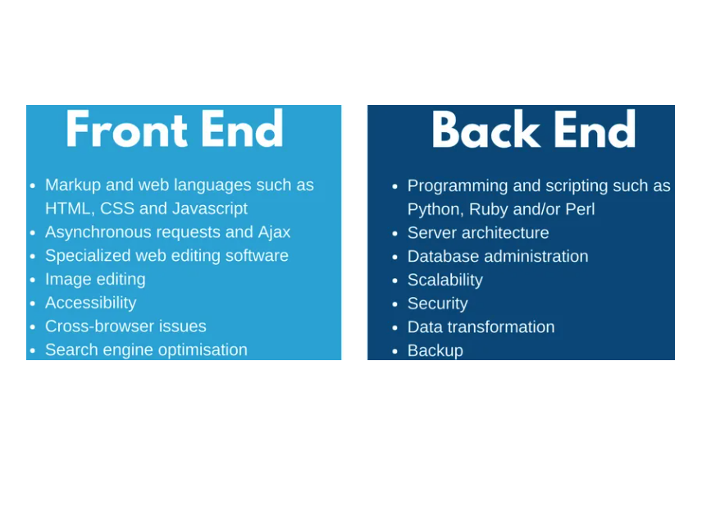
Backend Engineering

Slide 11
• Job prospects & demand: • Software Engineer/ Software Programmer/ Software Developer/ Backend Engineer/ Software Development Engineer. • DevOps & infrastructure, DBMS admin, security engineer, architect, product engineer, cloud software engineer, etc. • A day in the life of a backend / software engineer. • Generalist vs. specialist. • Safe job * • Less count of women. Role does not last > 5 years. * • Career progression: Management/ leadership roles. May not code. Lots of decision making / resource management / architecture decisions / product scope. * Disclaimer: • Depends on the company, team and responsibilities. • As observed during work experience.
Backend Engineering

Slide 12
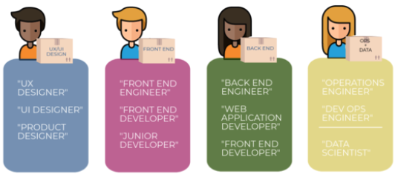
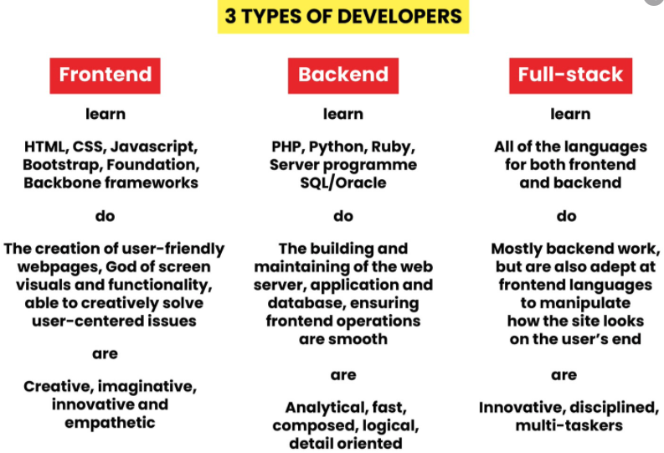
Backend Engineering

Slide 13


Backend Study Group

Slide 14
• Resources: • Backend Study Group: GitHub • Upcoming sessions: • April 8, 2021 • April 22, 2021 • Technical Tracks • Digital Events • Get updates – join the Digital mailing list! • Have questions?
• Contacts us at: contact@womenwhocode.com
• Join our Slack channel!
Thank you and see you soon!
Backend Study Group

